Slide 1
ONLINE JOB NOTIFIER

Slide 2

Gayatri Vidya Parishad College of Engineering
(Autonomous) Madhurawada, Visakhapatnam - 530048 Under the esteemed guidance
Dr . N.V.S LAKSHMIPATHI RAJU
Associate Professor
Department of CSE GVPCE-(A)
Project Team Members
SRILEKHA DEVINEEDI 19131A05M7
USHA LALAM 19131A05P0
SURYA CHIKKALA 19131A05N2
CHITNEEDI SRIDEVI 19131A0545

Slide 3
Abstract
Internet is a source of live data that is constantly updating with data of almost any field. Having tools that can automatically detect these updates and select that information that we are interested in, will have utmost importance now-a-days.
Web scraping is a method of extracting and restricting the data from web pages. This application can be used on different dynamic websites i.e.., job portals and automate the repetitive tasks.
It will reduce the manual work of going to a website and searching for new job multiple times. As the application collects the data from job portal and send it to the user.
This application will find new openings on job portals and alert the user by providing required information.

Slide 4
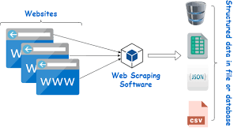
Introduction
WEB SCRAPPING:
Web Scrapping is a web technique for extracting data from the web and turning unstructured data on the web (including HTML formats ) into structured data that you can store to your local computer or a database.

Slide 5
Existing system
There are quite some platforms that are present right now which work on a subscription model with limited sources.
The old system requires applicants to search through visual media for job opportunities.
User needs to search for all the vacancies available and segregate them based on their preferred location and job role.
drawbacks
The most prevailing drawback of the existing work is that it requires a lot of the user’s time and manual work for selection.
Any platform right now synchronizes the user’s responses and shows the list of all the options that are available in their own site but unlike this our project performs all the analysis and sends a personalized selection of the jobs to the user’s socials.

Slide 6
Proposed work
A frontend application is designed where it takes the users input into consideration and after performing a thorough analysis and sends all the updates once a week.
Our application is a semi-automated process which performs repetitive tasks for the users inputs.
A notifier and periodic scheduling are added to the application which alerts the user when the job applications are open after every specified interval of time.
Since it is completely personalized, the frequency of visit is quite low.

Slide 7
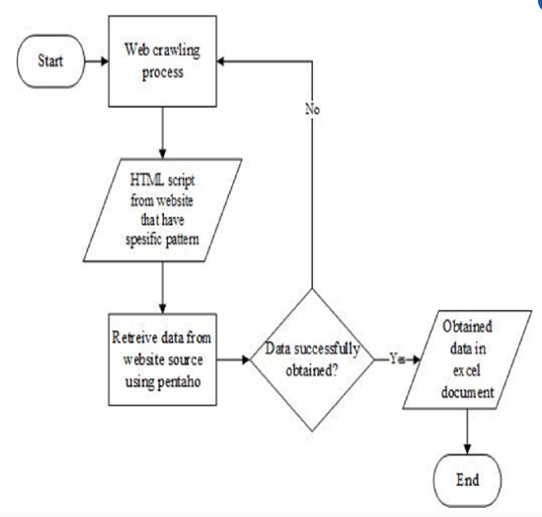
Block diagram
SYSTEM ARCHITECTURE

Slide 8
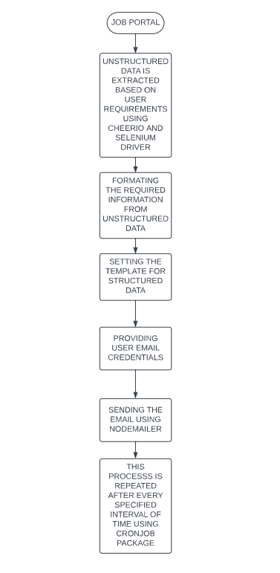
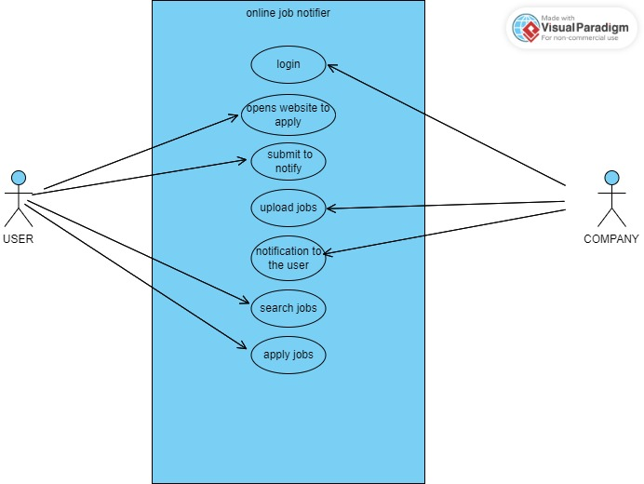
Block diagram
USE-CASE DIAGRAM
STATE CHART DIAGRAM

Slide 9
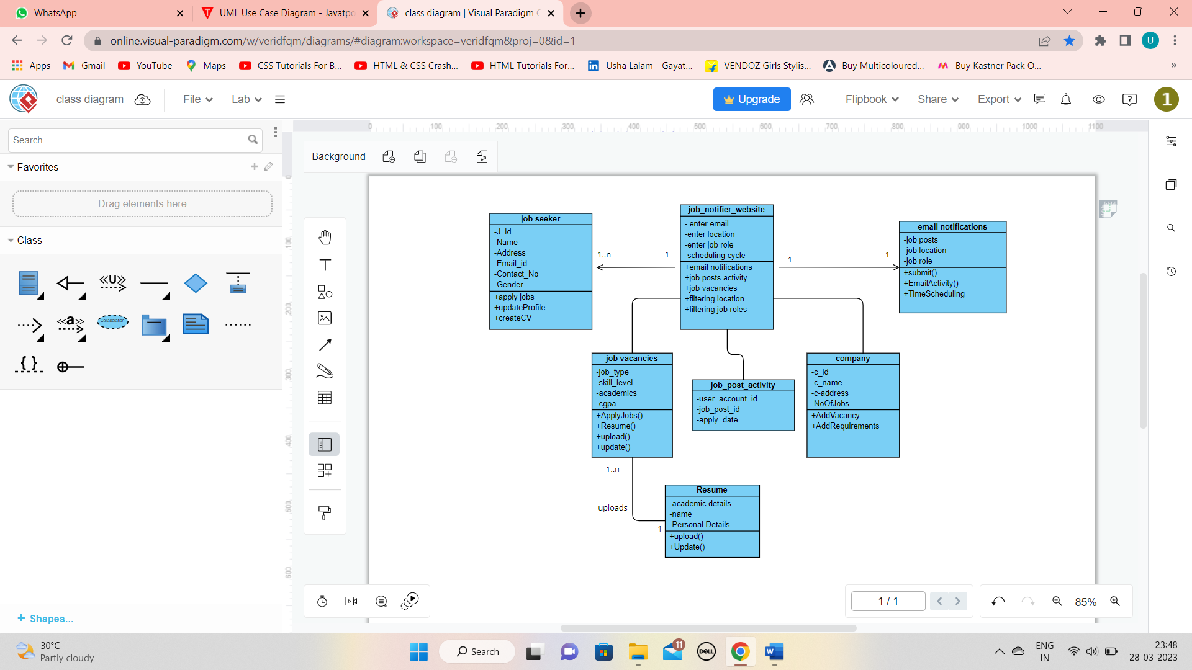
Block diagram
CLASS DIAGRAM

Slide 10
Software and hardware requirements
Domain: Web Scraping
Processor:i3,i5,i7
RAM:4GB/8GB
Operating System : Windows 11
Technology : JavaScript, Node Js,React Js
IDE:VS Code
Packages: cheerio.js, cron - job , nodemailer, shell.js, selenium web driver, cors, axios.

Slide 11
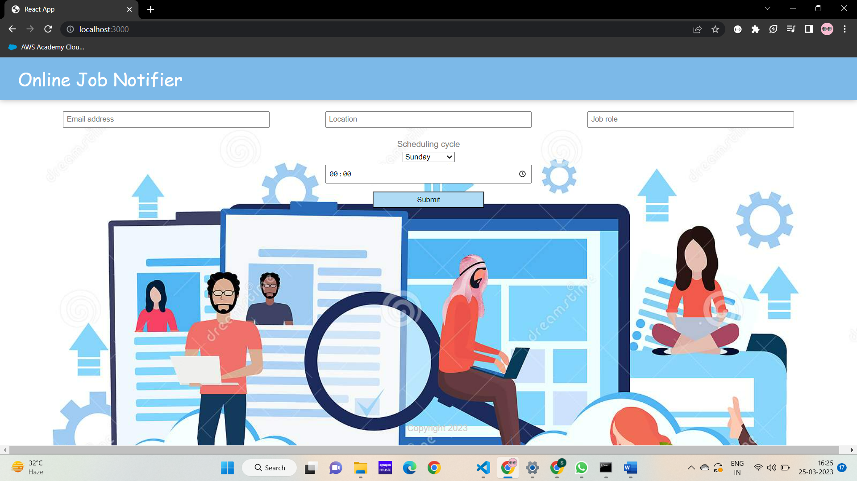
implementation
This is the frontend application where the user needs to enter their details.

Slide 12

implementation
The updates will be sent to the given email id as per the location and role mentioned. As per the inputs given in the scheduling cycle, the updates will be sent every week to the user in the given time and day.

Slide 13

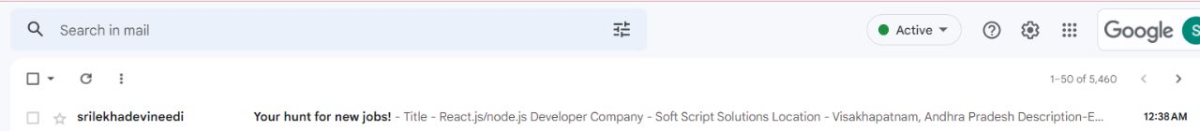
implementation
As soon as the user clicks on submit, the frontend will be rendered to a submit page which is a kind of acknowledgement to the user. And within few seconds the user will get an email with current job updates.

Slide 14
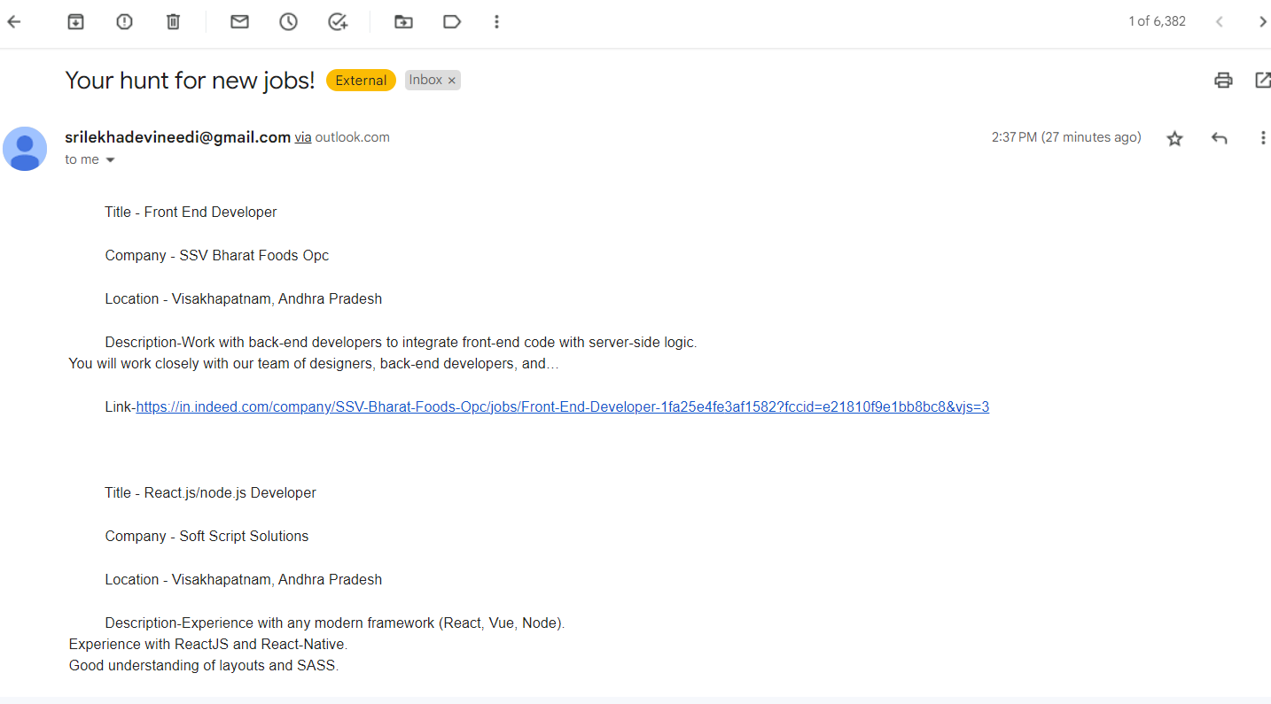
results
After opening the mail, all the available jobs will be displayed along with their links.

Slide 15
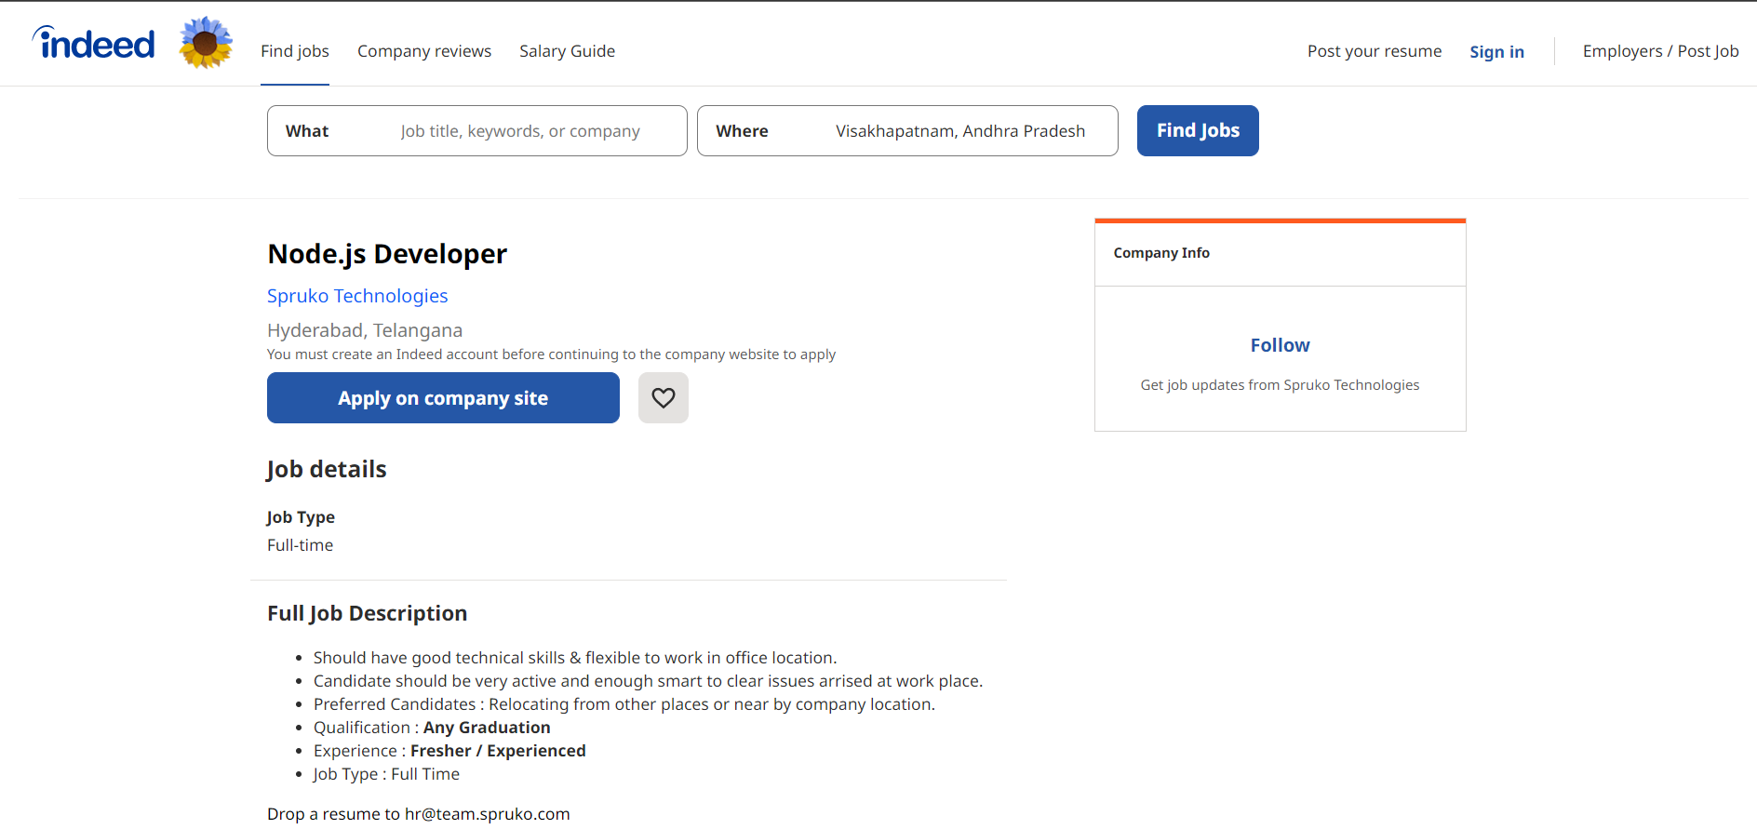
results
As soon as the user clicks on a link, the indeed website gets opened with all the details and an option to apply for the job.

Slide 16
conclusion
This project’s main goal is to make the life of the user easy by giving the right information regarding the job updates keeping the job role in mind.
The tools that this project uses for simplifying is entirely based on the responses of the user and that fields of area are focused, this is the reason that our selection and personalization works in the most effective and efficient way possible.
This project is developed using web scraping model which saves a lot of time to the user. The automation process for job searching is quite faster than the traditional manual process. Users are just a few clicks away to get connected. This application will be helpful in finding new openings on job portals which fall under his skillset and alert the user by providing required information.

Slide 17
FUTURE SCOPE
There is ample scope of enhancement and adding functionalities to this application. This application can be extended to send automated interview scheduling acceptance/rejection of resume. The application can have a job recommendation system based on frequent search result of different users. There can be a feedback or review section for the application. The application can be more scalable by extending the search functionality based on country, city or area. The User Interface can be made more attractive and user friendly.

Slide 18
references
Vivek Kumar Sehgal1, “Job Portal-A Web Application for Geographically Distributed Multiple Clients”, 1 Department of CSE and ICT Jaypee University of Information Technology, Waknaghat, Solan, H.P (INDIA)M. Young, The Technical Writer’s Handbook. Mill
Valley, CA: University Science, 1989.
”Ghvinian, Holbert, Viswanathan. “Simple Web Scraping.” Internet : https://seanholbert.wor dpress.com/2011/07/15/scrappy-simple-web
scraping/, Jun.2015”
3. “Datahen."3Advantagesofwebscrapingforyourenterprise"Internet:
https://www.datahen.om/3advantages-web-scraping enterprise/,May.17,2017”
https://en.wikipedia.org/wiki/Web_scraping
https://www.seobility.net/en/wiki/CronJob
https://ieeexplore.ieee.org/search/searchresult.jsp?newsearch=true&queryText=web%20scrapping

Slide 19
THANK YOU

